Slide 1
Slide 1: Title Slide
Project Title: Scalable Deep Learning with Distributed Training
Team Members: Sai Sri Ganesh Putsala, Savyasachi Thati
Course: Scalable Systems
Date and Institution

Slide 2

Agenda
Introduction
Project Objectives
Methodology & Architecture
Implementation & Training Strategy
Experimental Setup
Evaluation Metrics
Results (DP, DDP, FSDP)
Consequences of Large Model Training
Challenges & Limitations
Team Communication & Reflections
Conclusion
Future Work
Q&A

Slide 3
Introduction
The Rise of Deep Generative AI Models
Recent breakthroughs like DALL·E, Stable Diffusion, and ChatGPT have shown the potential of generative AI.
These models generate text, images, code, and more—transforming industries from healthcare to entertainment.
Need for Scalable Training Techniques
Model sizes and datasets are rapidly expanding.
Single-GPU training is insufficient due to memory, speed, and efficiency constraints.
Distributed and parallel computing is critical for training large models effectively.
Why This Project?
Hands-on experience with distributed AI model training.
Combines generative modeling (CVAE + diffusion) with real-world tools like PyTorch, CLIP, and FSDP.
Builds key HPC and MLOps skills—valuable for research and careers in AI engineering.

Slide 4
Project Goals
Implement Text-to-Image Generative Model
Build a deep learning pipeline using a Conditional Variational Autoencoder (CVAE) integrated with a diffusion model.
Generate high-quality images conditioned on textual input using CLIP embeddings.
Compare Scalability Across Training Strategies
Evaluate performance under multiple parallelism methods:
Data Parallelism (DP)
Distributed Data Parallel (DDP)
Fully Sharded Data Parallel (FSDP)
DeepSpeed (planned/future work)
Measure metrics like GPU utilization, training time, memory usage, and power efficiency.
Hands-On High-Performance Computing
Deploy model training on TACC’s Frontera supercomputer.
Gain practical experience in:
Multi-GPU distributed training
Model wrapping and checkpointing
Image synthesis workflows
Develop critical HPC and AI engineering skills applicable to cutting-edge research and industry.

Slide 5
Team Kickoff
Vision
Develop a text-to-image generative AI system.
Combine Conditional Variational Autoencoders (CVAE) with local Large Language Models (LLMs).
Push the boundaries of image synthesis using text as the conditioning signal.
Scope
Use diffusion learning to refine image generation.
Integrate pre-trained CLIP embeddings for semantic control.
Apply distributed training techniques to accelerate development.
Skills Developed
High-Performance Computing (HPC) usage with TACC Frontera.
Model tuning, debugging, and parallel execution.
Web scraping and dataset preparation techniques for text-image tasks.

Slide 6
Software & Tools Used
Core Libraries
PyTorch Framework for defining and training the CVAE model Supports CUDA operations and gradient optimization
torchvision Used for loading and preprocessing the CIFAR-10 dataset Includes transforms and utility functions for image data
transformers (Hugging Face) Loaded CLIPTokenizer and CLIPTextModel Extracted meaningful text embeddings for label conditioning.
Parallelism & Optimization
Fully Sharded Data Parallel (FSDP) From torch.distributed.fsdp Used to shard model parameters, gradients, and optimizer states Enabled memory-efficient training of large models
Mixed Precision Training Integrated torch.amp and GradScaler Reduced memory footprint and improved throughput
torch.utils.checkpoint Used for memory-efficient forward passes Applied to encoder layers to reduce GPU memory spikes.
HPC Infrastructure
SLURM Scheduler on TACC Frontera Job submission and node allocation for distributed runs SLURM variables used to configure rank, local rank, and world size
NCCL Backend High-speed GPU communication for distributed training Used under the hood for FSDP synchronization

Slide 7
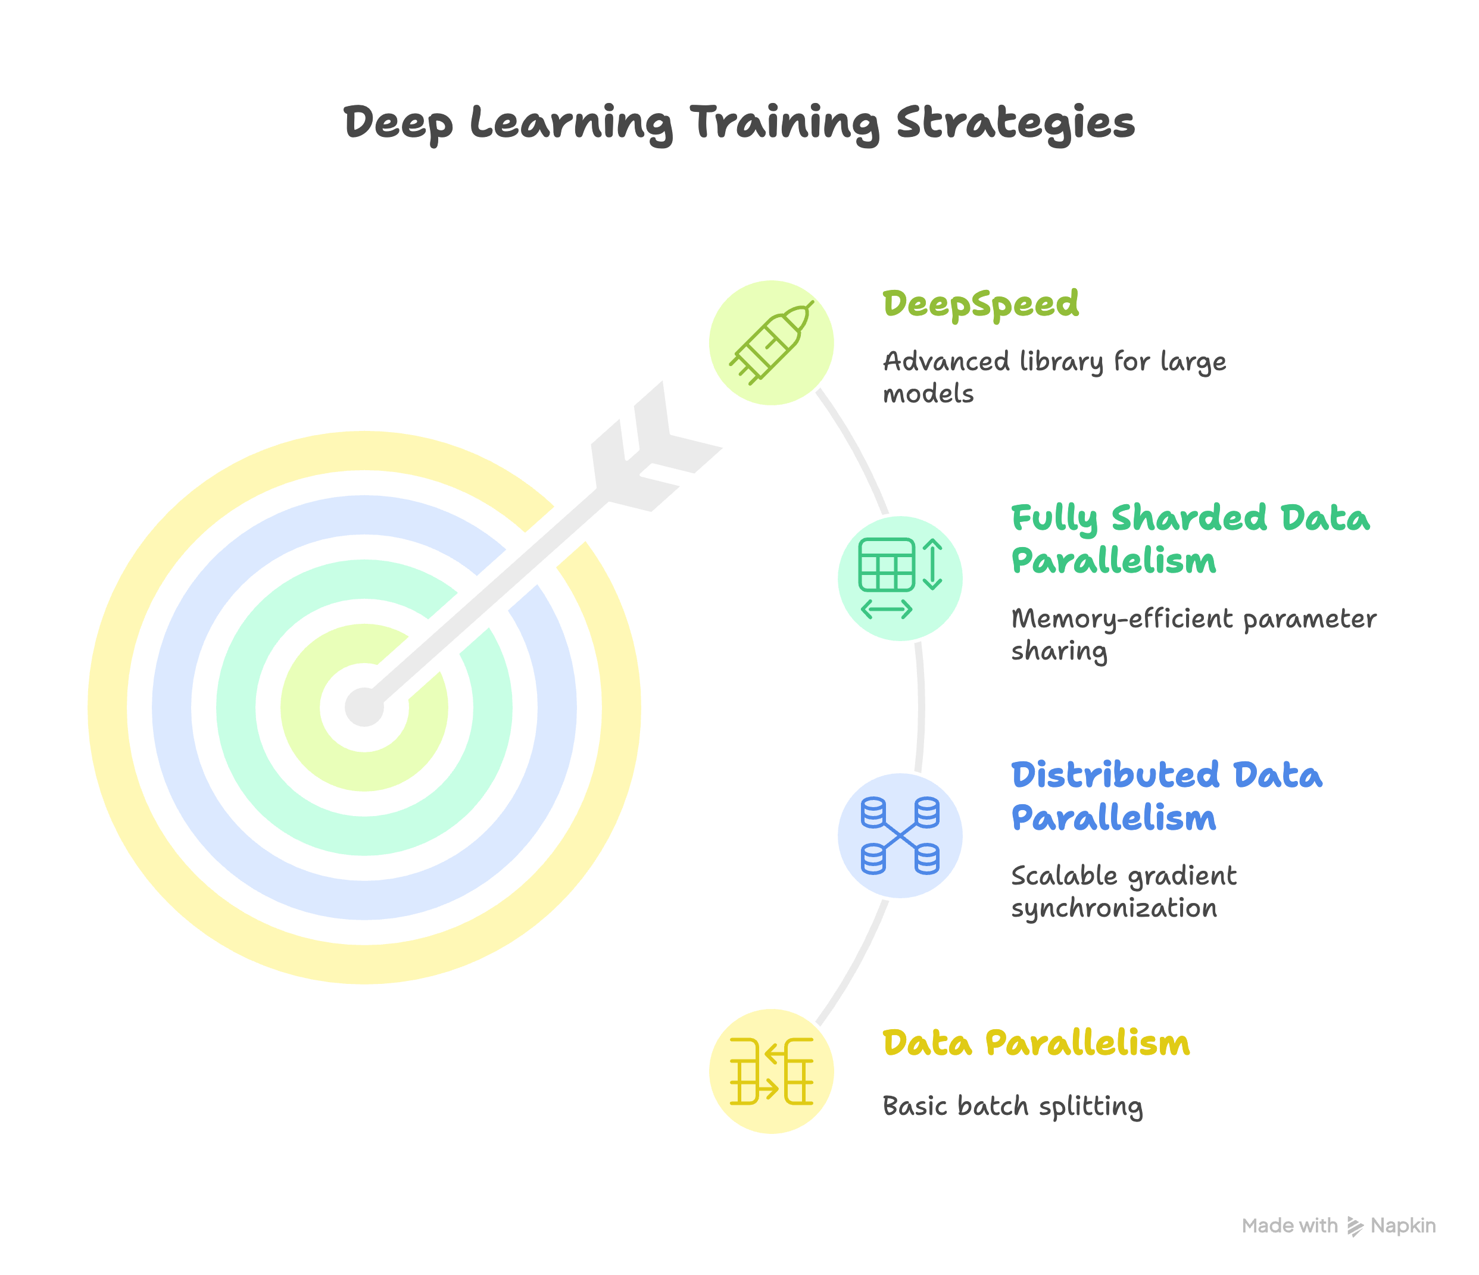

Slide 8
Methodologies
Data Parallelism (DP)
Model replicated across GPUs; batches split.
Easy to implement but suffers from high communication overhead.
Distributed Data Parallelism (DDP)
Model replicated per GPU process; gradients synced via all-reduce.
Improved scalability and GPU utilization.
Fully Sharded Data Parallelism (FSDP)
Parameters, gradients, and optimizer states are sharded across GPUs.
Optimized for memory efficiency and large model training.
DeepSpeed (Planned/Future Work)
Microsoft’s advanced training library.
Enables ZeRO optimization, model/optimizer partitioning, and efficient scaling to billion-parameter models.

Slide 9
Training Strategy
1. Mixed Precision Training
Utilized Automatic Mixed Precision (AMP) from torch.amp
Enabled faster computation and reduced memory usage by using float16 where safe
GradScaler used to prevent underflow during backward pass
Helped stabilize training on high-resolution (512×512) images

Slide 10
2. Checkpointing for Memory Efficiency
Applied torch.utils.checkpoint to encoder layers of the CVAE
Activations recomputed during backward pass instead of being stored
Reduced peak GPU memory usage by delaying computation
Critical for supporting larger spatial dimensions during forward passes

Slide 11
3. Text-Based Label Embedding with CLIP
Used CLIPTokenizer and CLIPTextModel from Hugging Face
Converted class labels (e.g., "cat", "airplane") into dense semantic embeddings
These embeddings conditioned both the encoder and decoder of the CVAE
Provided meaningful context for generating class-specific image reconstructions

Slide 12
Distributed Setup
1. Multi-GPU Training with SLURM + NCCL
Training was deployed on TACC Frontera using SLURM job scheduling
Multi-GPU nodes were accessed via SLURM environment variables:
SLURM_PROCID, SLURM_LOCALID, SLURM_NODELIST
Used NCCL (NVIDIA Collective Communication Library) as the backend for efficient GPU-to-GPU communication
Launched training across multiple processes (1 per GPU) to enable full parallelism

Slide 13
Manually extracted:
Global Rank: identifies the process across the entire cluster
Local Rank: identifies the GPU index per node
World Size: total number of processes/GPU workers
Set the CUDA device with torch.cuda.set_device(local_rank)
Ensured consistency by broadcasting the MASTER_ADDR and MASTER_PORT environment variables

Slide 14
3. Weight Broadcasting and Synchronization
Synchronized model parameters across all GPUs at startup
Used torch.distributed.broadcast to share initial weights from rank 0 to all other processes
This step ensures every GPU starts training from the exact same model state
Also initialized FSDP with sync_module_states=True to avoid parameter desyncs

Slide 15
Model Training Process
1. Dataset: CIFAR-10
Standard dataset with 60,000 images across 10 classes
Each image originally 32×32, scaled up to 512×512 resolution using torchvision.transforms.Resize
Classes (e.g., airplane, dog, truck) used as input labels for CLIP-based text conditioning
Dataset split handled internally with torchvision.datasets.CIFAR10 and DistributedSampler

Slide 16
2. Loss Function: L1 + KLD (CVAE Objective)
L1 Loss (Reconstruction): Measures pixel-wise difference between original and reconstructed images
Kullback-Leibler Divergence (KLD): Regularizes the latent space to resemble a standard normal distribution
Final loss:
Loss=L1(x,x^)+0.1⋅KLD(z)\text{Loss} = \text{L1}(x, \hat{x}) + 0.1 \cdot \text{KLD}(z)Loss=L1(x,x^)+0.1⋅KLD(z)
Balances image quality and latent regularization to avoid overfitting

Slide 17
3. Epoch-Wise Training Loop
For each epoch:
Text labels converted to CLIP embeddings
Input image and label embedding passed through the CVAE
Loss computed, backpropagated, and optimizer updated
After each epoch:
Model checkpoint saved
Random latent vectors + text used to generate new samples
Output images saved via torchvision.utils.save_image() for visual inspection

Slide 18
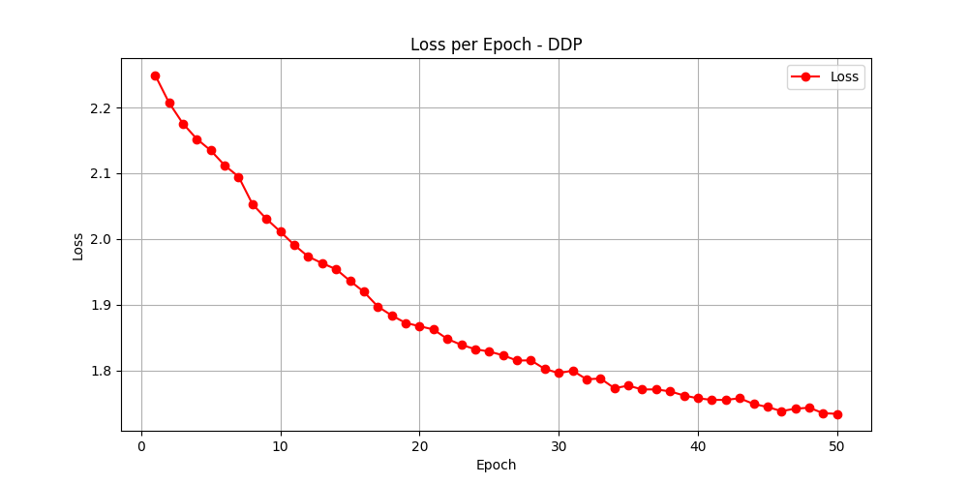
Results
1. Training Loss Trajectory
Tracked epoch-wise total loss combining L1 and KLD terms
Observed consistent downward trend, indicating stable convergence
Early epochs showed rapid improvement; later epochs fine-tuned details
Demonstrated that FSDP-wrapped CVAE effectively learned semantic structure from CLIP-conditioned inputs

Slide 19
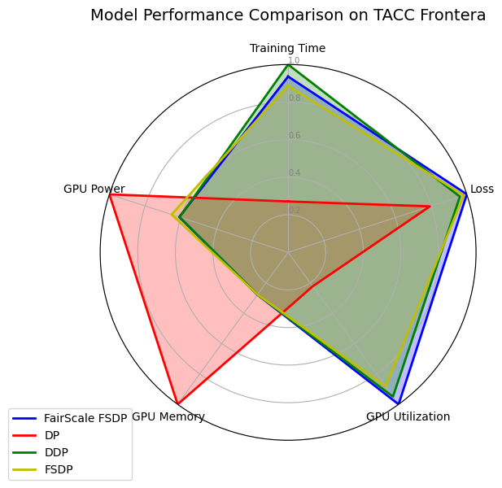
2. Generated Sample Images
After each epoch, model decoded random latent vectors with random text labels
Generated 512×512 color images conditioned on classes like “dog”, “airplane”, “cat”, etc.
Images saved using save_image() for evaluation
Visual inspection confirmed class alignment and image sharpness improved over time

Slide 20
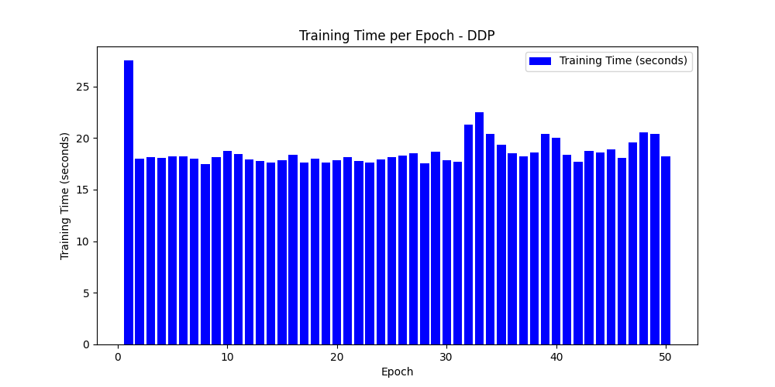
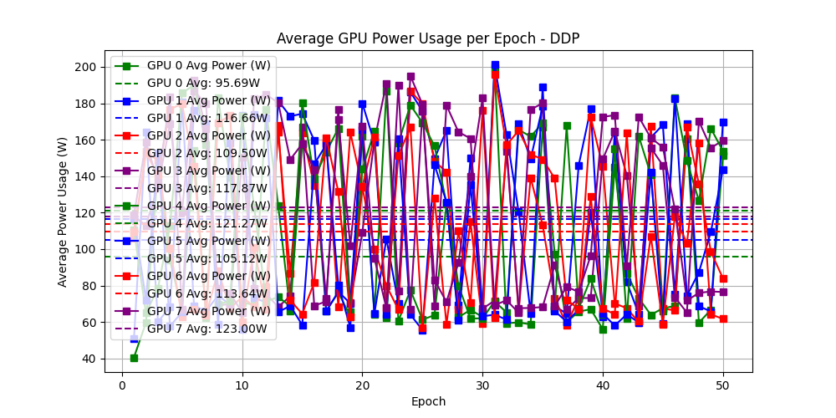
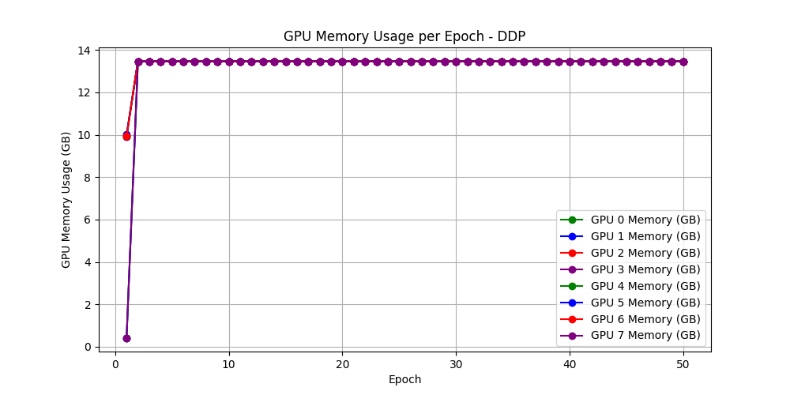
3. Resource Usage Observations
GPU Memory: Efficient usage due to torch.utils.checkpoint and FSDP
Enabled training at 512×512 resolution within 40–50% of GPU memory footprint
Training Time:
First epoch longer due to model sDDP_training_time_bar.pngetup & syncing
Subsequent epochs stabilized (~20s per epoch)
Mixed Precision + FSDP:
Reduced computation cost
Allowed 4-image batches even at high resolution

Slide 21
Challenges Faced
1. FSDP Synchronization and Wrapping Issues
Proper FSDP wrapping required care to avoid parameter sync mismatches
Initial model state needed to be broadcasted manually from rank 0 to all GPUs
Some training inconsistencies occurred when resuming checkpoints or switching devices
Used sync_module_states=True and manual weight broadcasting to address this

Slide 22
2. Large Image Resolution Bottlenecks
Training on 512×512 images caused significant GPU memory stress
Especially challenging during gradient accumulation and optimizer updates
Solved using:
Gradient checkpointing (torch.utils.checkpoint)
Mixed precision training (torch.amp and GradScaler)
Still had to limit batch size to 4 even on high-memory nodes

Slide 23
3. Debugging Across Distributed Processes
Errors in distributed mode often appeared only on one rank, making them hard to detect
Debugging issues like tensor shape mismatches or NaN losses was time-consuming
Needed to insert rank-specific print/debug statements and use SLURM logs to trace root causes
Required careful synchronization to avoid hanging processes or deadlocks

Slide 24
Conclusion
1. Achieved Scalable, High-Resolution Image Generation
Successfully trained a text-conditioned CVAE model on 512×512 images using distributed GPU infrastructure
Integrated CLIP embeddings to guide image reconstruction based on class labels
Employed Fully Sharded Data Parallelism (FSDP) to scale training across GPUs while reducing memory usage
Generated and saved class-conditional samples after every epoch for qualitative analysis

Slide 25
2. Developed Hands-On Skills in Scalable AI Systems
Gained real-world experience in configuring and launching multi-GPU training jobs using SLURM and PyTorch Distributed
Applied mixed-precision training, gradient checkpointing, and manual synchronization techniques for optimization
Learned to use and troubleshoot FSDP, handle large image processing, and integrate Hugging Face CLIP models
Built a practical foundation in HPC pipelines, distributed systems, and deep learning model deployment on clusters

Slide 26
Future Work
1. Add Diffusion Model Layer
Extend the current CVAE architecture by integrating a denoising diffusion module
Enables the model to refine generated images step-by-step for higher quality and realism
Conditioning the diffusion process on both latent vectors and text embeddings will improve sample diversity and detail
Planned structure:
CVAE for latent encoding
Diffusion U-Net for progressive generation in pixel space

Slide 27
2. Integrate DeepSpeed
Explore Microsoft’s DeepSpeed to:
Support training larger models with ZeRO-3 optimizer state sharding
Improve training throughput and memory efficiency even further
Evaluate and compare performance with FSDP in terms of speed, memory, and convergence
Integrate DeepSpeed CLI and config JSONs for dynamic strategy selection

Slide 28
3. Expand to Larger Datasets (e.g., MS-COCO)
Move beyond CIFAR-10 to train on rich, diverse datasets like:
MS-COCO: Real-world image-text pairs with captions
ImageNet subsets for higher resolution and class variability
Will enable:
More meaningful text-to-image generation
Better generalization performance
Multi-word prompts and caption-based conditioning

Slide 29
Q&A

